Slide 1
MITRE ATT&CK

Slide 2
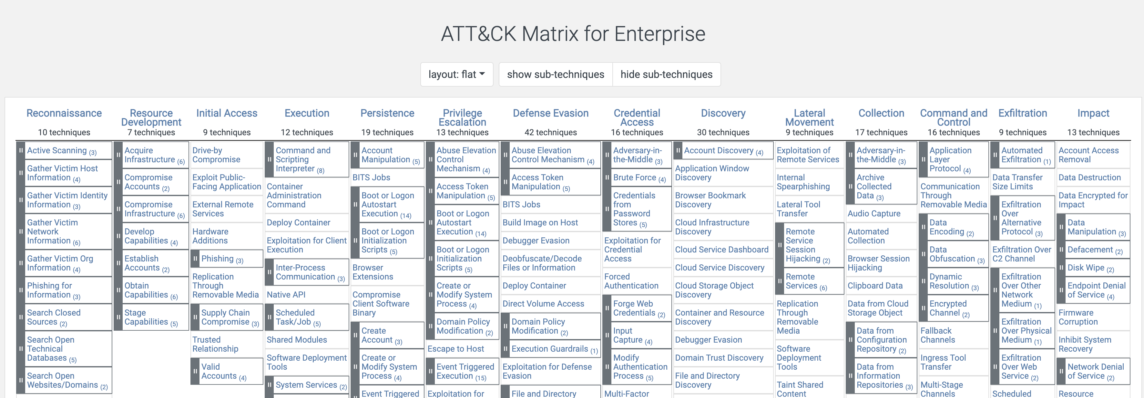
MITRE ATT&CK
https://attack.mitre.org/
Learn MITRE ATT&CK to understand the flows.

